Slide 1
CS 4530: Fundamentals of Software Engineering Module 8: React Basics
Adeel Bhutta and Mitch Wand
Khoury College of Computer Sciences
© 2025 Released under the CC BY-SA license

Slide 2
Learning Objectives for this Lesson
By the end of this lesson, you should be able to:
Understand how the React framework binds data (and changes to it) to a UI
Create simple React components that use state and properties
Notes:
Tonight's subject is REACT, our web framework. We have two lessons,
roughly: basic REACT, and advanced REACT.
<Read slide>

Slide 3

HTML: The Markup Language of the Web
Language for describing structure of a document
Denotes hierarchy of elements
What might be elements in this document?
Notes:
HTML is the markup language of the Web.
It is a language for describing the structure of a document.
And it does so by denoting the hierarchy of elements in the document.
On the right, we see an article from a newspaper and an electronic version of it.
We can see that the article has a title, a subtitle, an image, and multiple paragraphs in it.
These are all elements that can be found in html.

Slide 4
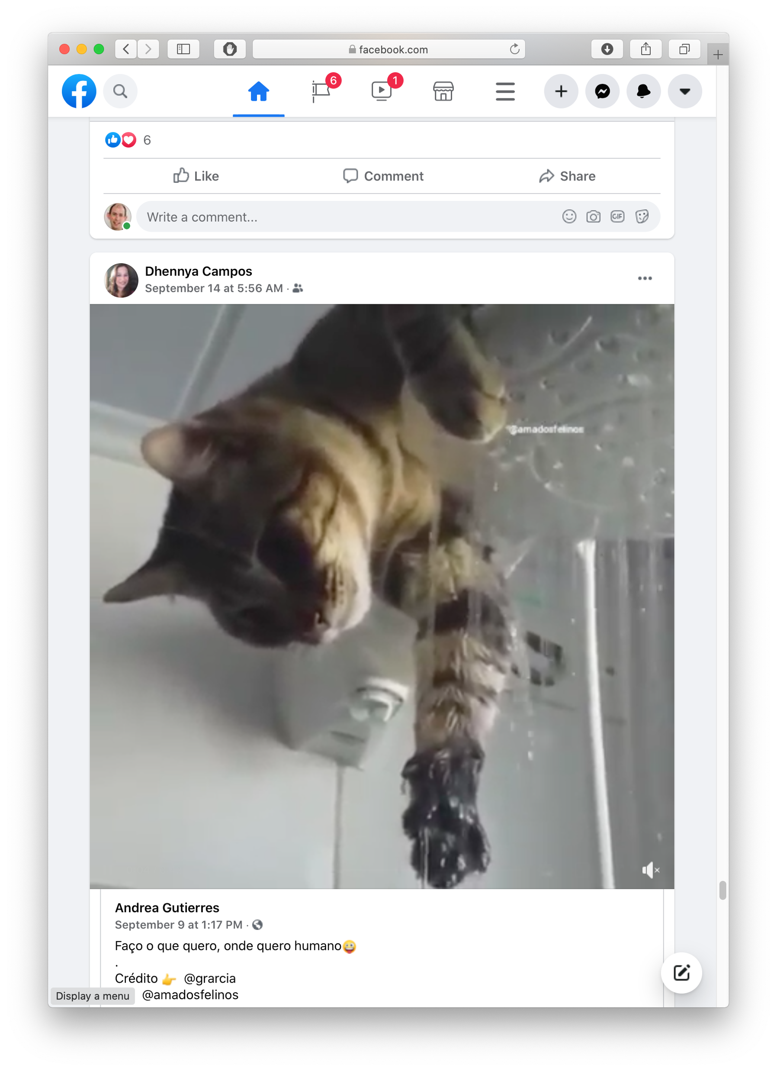

Rich, interactive web apps
Infinite scrolling of cats
Notes:
HTML only gives us only static web apps.
In order to build more complicated logic and add interactivity, we need to add JavaScript.
If we want to add much more complicated features a such as infinitely scrolling cats where the page automatically loads more data as we scroll, we would want something more than just JavaScript.
We need something which brings repeatability and structure to JavaScript, which will make development easy.
One framework for doing just that, is React, which we will look at in the further slides.

Slide 5

Typical properties of web app UIs
Each widget has both visual presentation & logic
Some widgets occur more than once
e.g., comment/like widgets
Changes to data should cause changes to widget
e.g., new images, new comments should show up in real time
Widgets have hierarchical structure
Action on a widget may affect other widgets
e.g., clicking on 'like' button executes some logic related to the widget itself,
It may also affect the widget the contains the ‘like’ button
Notes:
Before jumping straight into React, let us study some of the typical properties of web application Uis,
Interactive web apps are made up of widgets. A widget is an element with which a user interacts.
It has visual representation, as well as logic.
A widget might appear multiple times on a single page, such as the like and comment widget for each image.
And any changes to the data should update the widget.
Such as new images or comments showing up in real time.
For example, Clicking on a like button executes some logic related to it.
Logic and presentation of a widget are strongly coupled, but different widgets are loosely related.
But how do we build such widgets?

Slide 6
Components represent widgets in object-like style
Organize related logic and presentation into a single unit
Includes necessary state and the logic for updating this state
Includes presentation for rendering this state into HTML
Synchronizes state and visual presentation
Whenever state changes, HTML should be rendered again
Notes:
Components organize the logic and presentation into a single unit.
This includes the state, and the logic necessary to update the state.
And it also includes the presentation for rendering this state.
Components also synchronize the state with its presentation, meaning that whenever the state changes, this updated html is rendered to the screen.

Slide 7
Components Example: Like button component
What does the button keep track of?
Is it liked or not
What post this is associated with
What logic does the button have?
When changing like status, send update to server
How does the button look?
Filled in if liked, hollow if not
Notes:
Let's go a little deeper into components and understand the like button component in terms of the data and presentation it needs to manage.
So, what does the like button keep track of?
It tracks whether the post is liked or not,
And it keeps track of what post it is associated with.
What logic does this button have?
When the like status is changed, it sends an update to the server.
And how does it look?
It is filled in if the post is liked and is hollow if not.

Slide 8
React is a Framework for Components
Created by Facebook
Powerful abstractions for describing UI components
Official documentation & tutorials: https://reactjs.org/
Components are constructed in the browser (“front-end”)
Key concepts:
Embed HTML in TypeScript
Track application “state”
Automatically and efficiently re-render page in browser based on changes to state
But: some implementations of React allow components to be pre-constructed in the server.
Notes:
And finally, we are going to talk about React!
React is a front end framework for building components.
It was created by Facebook in May of 2013.
It provides powerful abstractions for creating and describing components.
Some of the key concepts that we will cover include:
Embedding HTML in Typescript.
Tracking application state.
And how React automatically and efficiently re-renders parts of the page through a process called reconciliation.

Slide 9
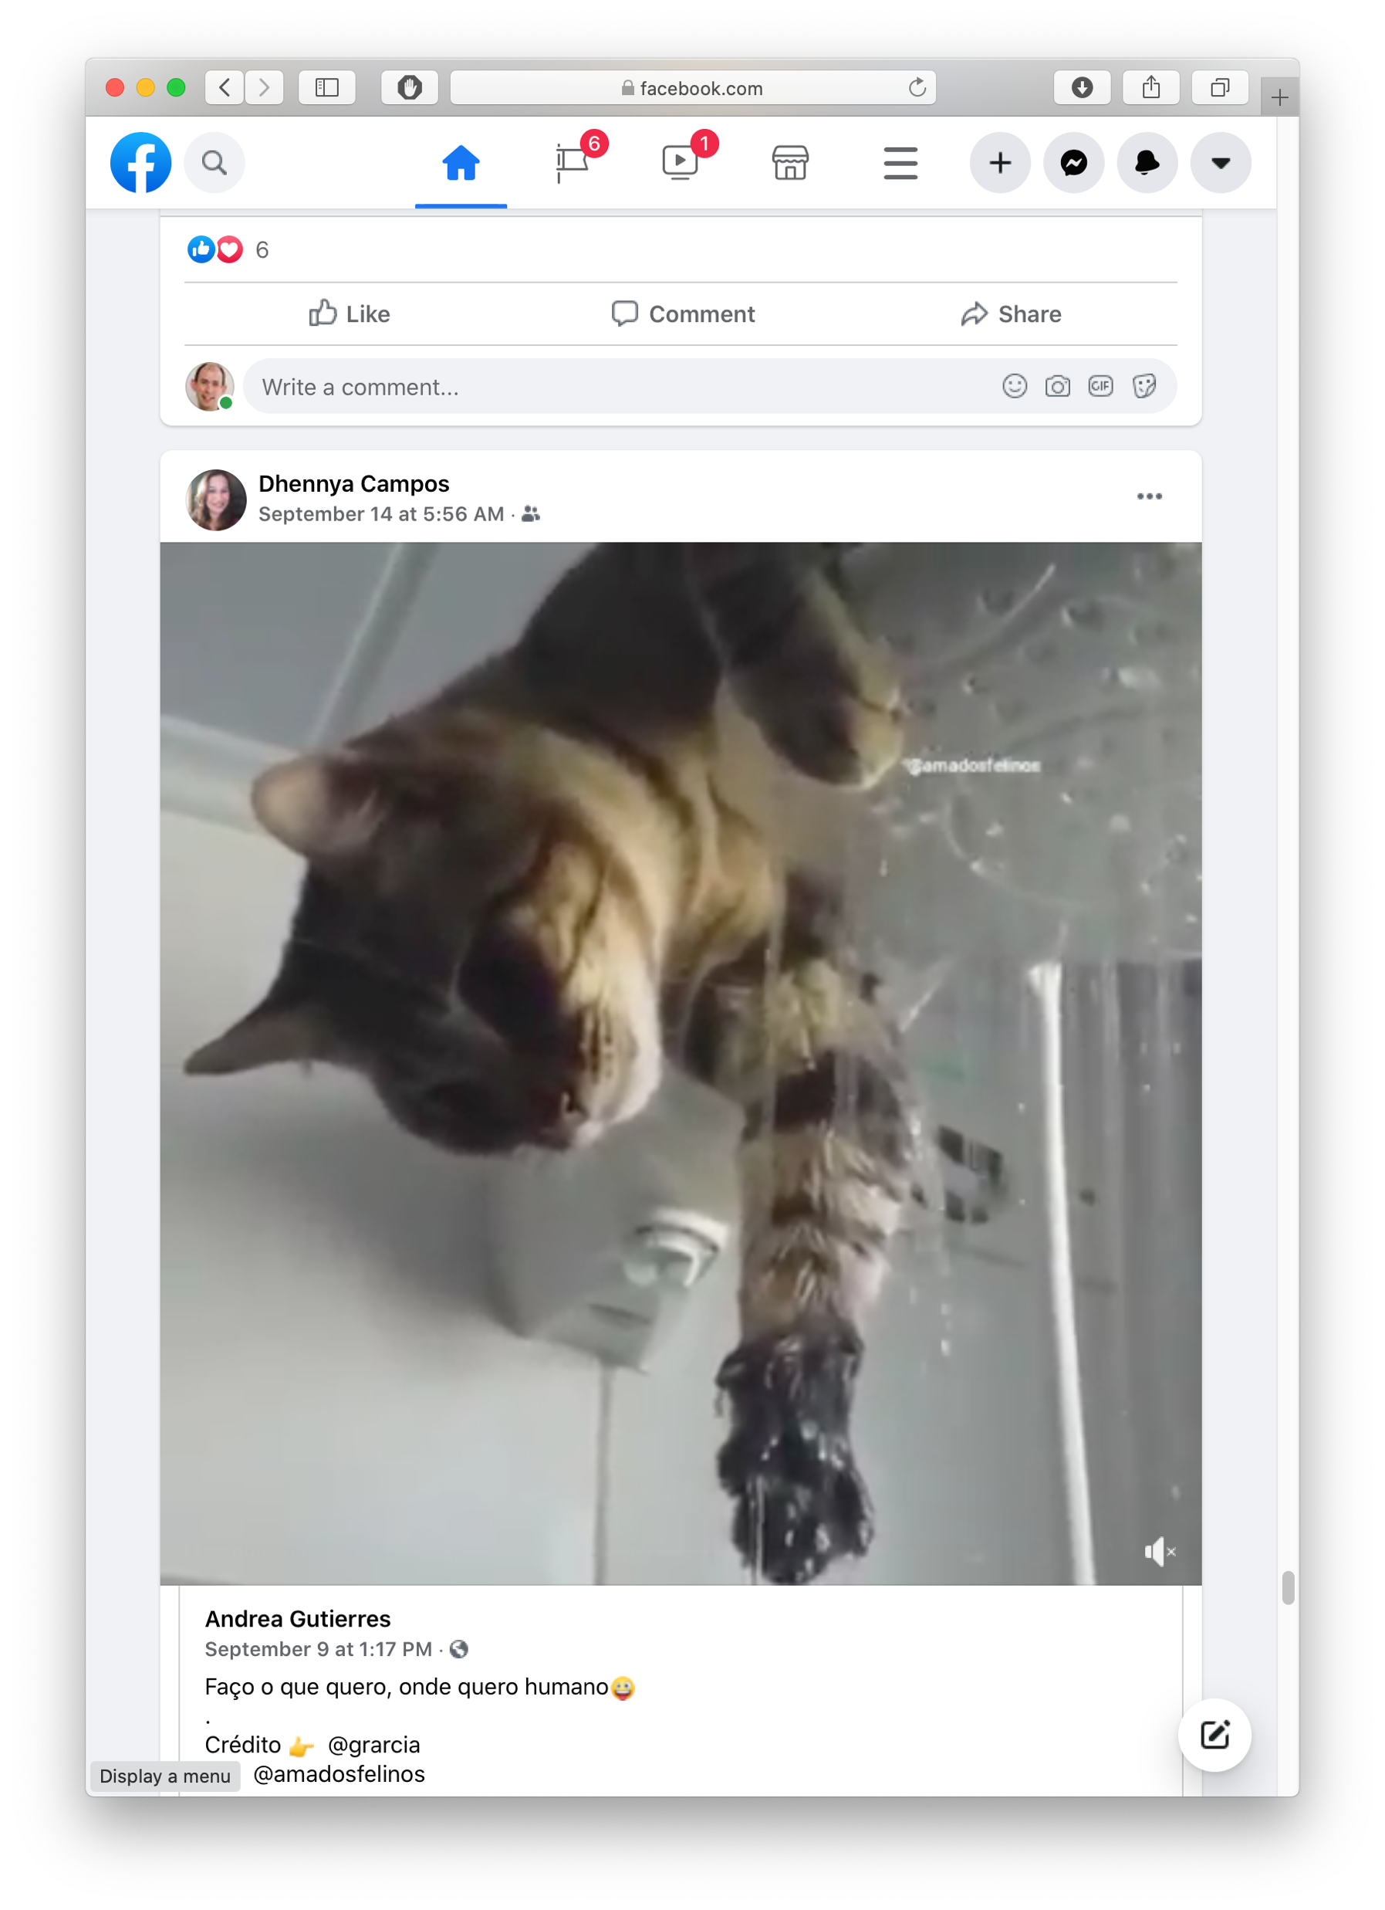

React makes it easy to build rich, interactive web apps (perhaps with infinite scrolling of cats!)
Built with React
Plus, AirBNB, Uber, Pinterest,
Netflix, Twitter and 8855 more
Notes:
React is and has been among the most popular frameworks for front end development for the past few years.
A lot of applications that we use everyday use React.
Some of these include Facebook, Instagram, AirBNB, Netflix and Twitter.
That 8855 number is pretty old-- I'm sure it's much much larger now.

Slide 10
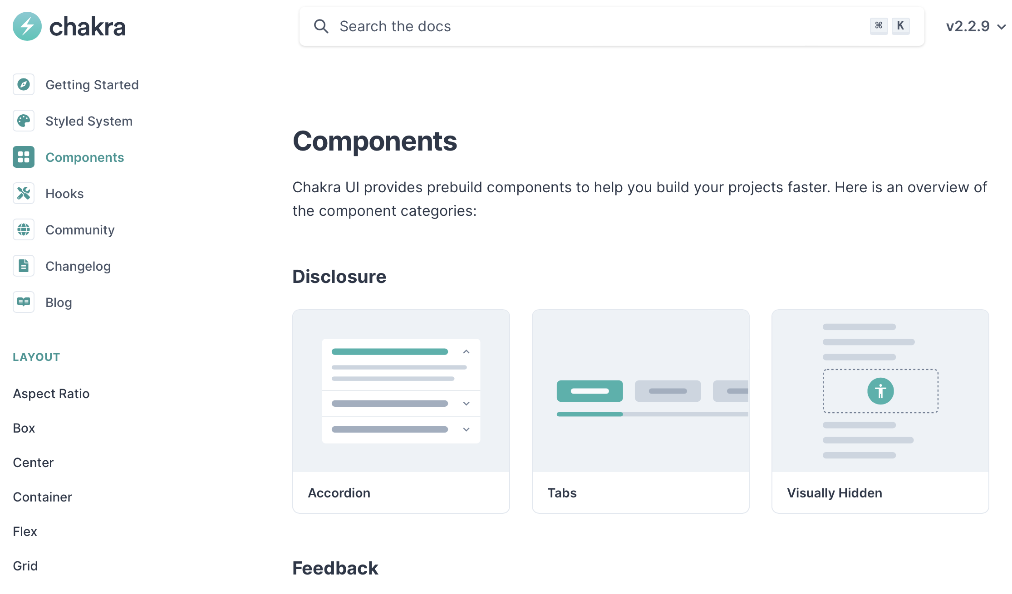
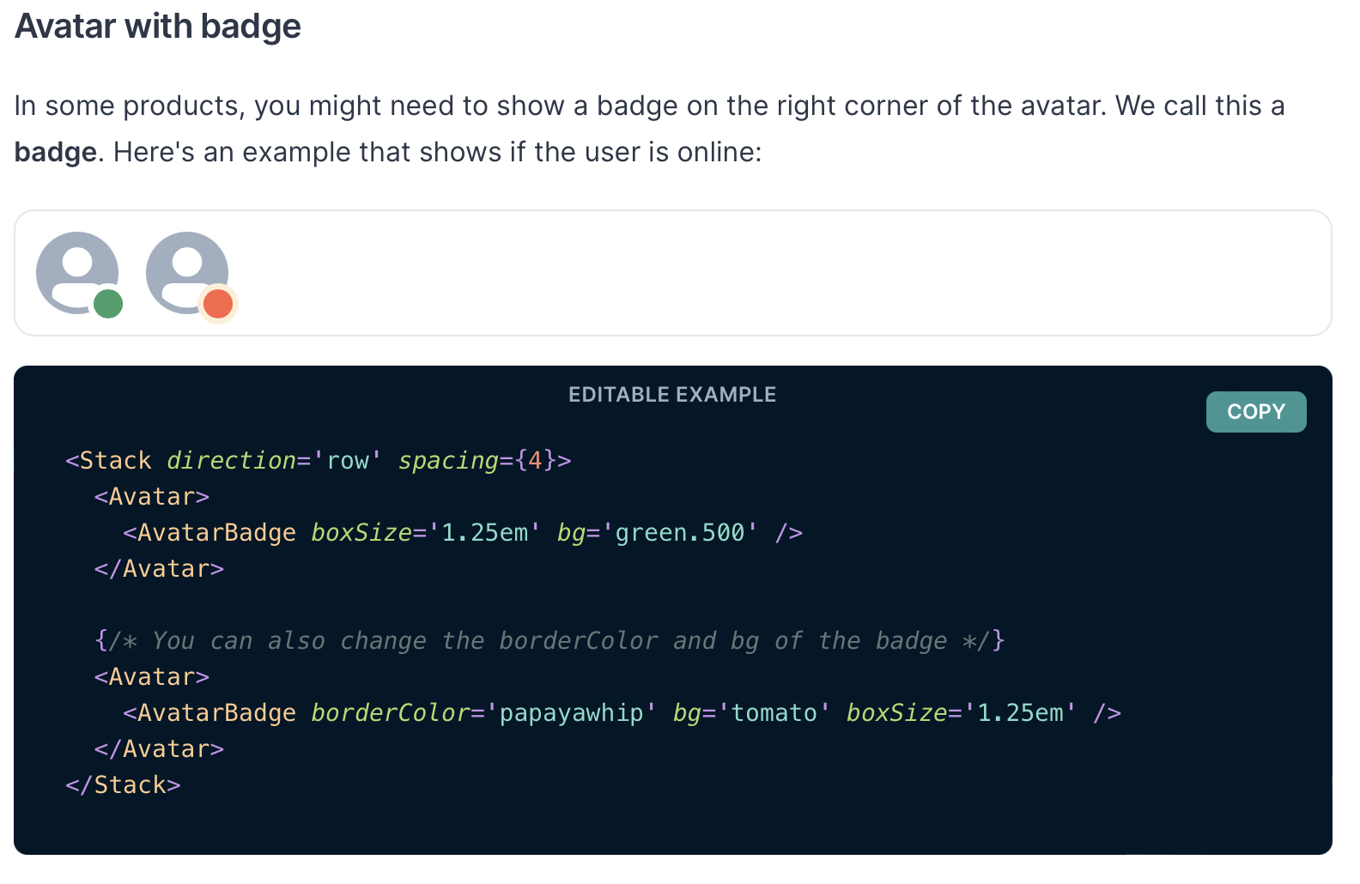
React Has a Rich Component Library
Notes:
Part of the idea with components is that they can be easily packaged up, shared, and reused. In the preceding video, we saw a couple of examples of these: the IconButton, and the heart icon. These components come from a popular React component library called Chakra UI. The Chakra UI web page lists all of the components in the library, and we show another example component on the right - the avatar component.
We like Chakra UI because it was built from the ground up to be compliant with web accessibility standards - it is possible to make accessible application using other frameworks, too, but starting with accessibility in mind is a good practice to ensure that you do not inadvertently create something that is challenging to adapt.
Other popular component libraries include Material UI and ANT Design.

Slide 11
Installing Chakra for next.js:
Just say:
npm i -–save @chakra-ui/react @chakra-ui/next-js
npm i --save @emotion/react @emotion/styled framer-motion
Notes:
Here's the incantation to install Chakra for next.js . The first line installs Chakra proper, the second line installs a package to
If you start with one of our premade projects, we've already done this for you, so no worries.

Slide 12
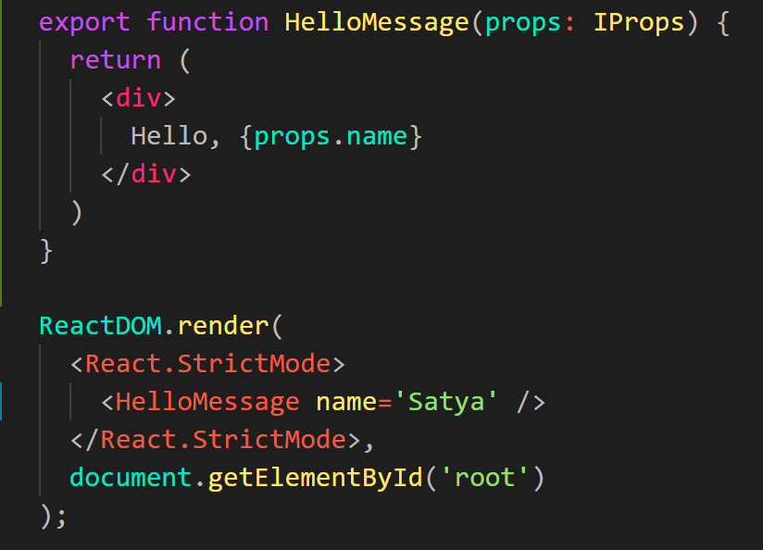
Embedding HTML in TypeScript Aka JSX or TSX
How do you embed HTML in TypeScript and get syntax checking?
Idea: extend the language: JSX, TSX
JavaScript (or TypeScript) language, with additional feature that expressions may be HTML
It’s a new language
Browsers do not natively run JSX (or TypeScript)
We use build tools that compile everything into JavaScript
Notes:
In React, we embed our HTML in Typescript.
We extend the language to include the additional features that we want.
This creates a new language called Reactive JS/TS with the extension jsx and tsx respectively.
Since this is a completely new language, the browsers do not run it natively.
We need to use some tools to compile the code to javascript.

Slide 13
JSX/TSX Embeds HTML in TypeScript
Example:
HTML embedded in TypeScript
HTML can be used as an expression
HTML is checked for correct syntax
Can use { expr } to evaluate an expression and return a value
e.g., { 5 + 2 }, { foo() }
To wrap on multiple lines, wrap the TSX/JSX in parentheses (…)
Value of expression is a piece of HTML
return <div>Hello {someVariable}</div>;
Notes:
React uses an extended syntax to include HTML in Typescript.
This allows us to use HTML as an expression in typescript.
An example of this is returning an html element instead of a value or variable.
This allows the html to be checked for correct syntax.
And within this html element, we can add expressions using the curly braces.
For example, writing 5 + 2 in the curly braces would print 7 in the html.
Similarly, calling the function foo() would evaluate the value that foo returns.
We can use this expression to bind data from our component to the html.

Slide 14
Hello World in React
src/app/Apps/HelloWorld.tsx
import * as React from 'react';
import { Heading, VStack } from '@chakra-ui/react';
function HelloWorldComponent() {
return (
<VStack>
<Heading>Hello World</Heading>
</VStack>
)
}
“Return this HTML whenever the component is rendered”
The HTML is dynamically generated by the library.
Notes:
OK! Here is our first React component.
Here we’ve defined a “Hello World” component The name must begin with a capital letter and it must return some html. Here’s we’ve returned some styled html using the Chakra UI library.
We'll demo this in a moment.
This component contains no logic or data and returns the same html every time. You could add some logic so that it didn't return the same html every time-- that's the main subject of this lecture.

Slide 15
Start your app by importing it into src/app/page.tsx
src/app/page.tsx
'use client'; // this app is client-side only.
import App from './Apps/HelloWorldApp' // or from wherever you app lives
// import App from './Apps/HelloWorldDave'
// import App from './Apps/App1';
export default function HomePage() {
return (
<ChakraProvider>
<App />
</ChakraProvider>
)
}
Notes:
The convention in next.js is to display whatever is the default export from a file called app/page.tsx.
Here is the file pages.tsx in the package’s app directory
I’ve set it up to import apps from a set of other files in the package. This is way simpler than the default version of this file that you get from next.js.
If you try this, you'll see a whole bunch of other imports, pointing to all the different apps that we have in this module (and the next). Simply uncomment the one that you want (and comment out any others).
The 'use client' at the top is necessary magic to get useState to work (useState only works on the client side). In general, components can be constructed on the server as well, but that's beyond the scope of this course.
The <ChakraProvider> is necessary magic to get the Chakra components to work correctly. (Try leaving it out and see what happens!)
<now demo helloworld>

Slide 16
React Components are Little Machines
They start with input from their creator (parent) (props)
They have additional local state ("component state")
They retain their local state when their parent's state changes
They may change their local state in response to external stimuli (button presses, etc.)
They re-render when their local state changes, or when they are re-created by their parent with different props.

Slide 17
Component State is Data That Changes
State is created by useState.
The state is accessed through state variables in the component.
The first variable is the accessor, the second is the setter.
The only way to change the value of a state variable is with the setter
In general, the state consists of several variables.
The component only re-renders after its local state changes
import { useState } from 'react';
function Foo() {
const [count, setCount] = useState(0)
….
}
You could choose any names for the variable and its setter; for this class, please follow the naming convention (goodVariableName, setGoodVariablename) that we’e used here.
Notes:
“State” is component data that changes. It is important to distinguish data that doesn’t change from data that does change because changes to data should result in the component re-rendering. That is, when the data changes, we want our component to “react” to the change visually.
With React, we define state variables by calling the special method “useState”. `useState` takes a single parameter, which defines the default value of the state.
It returns an array with two elements: the first element is the value of the state variable, and the second is a setter which is used to change the state variable - the code on line 3 of the example on the right is typescript shorthand for saying: “declare a variable `count`, and set it to the first element of the array returned by useState, and declare another variable `setCount`, and set it to the second element in that array”
All updates to state must be made through the setter function.
React doesn’t care what names you choose for these variables; however for this class, we care that you choose a good variable name (as covered in our general design principles), and call the setter something like “setGoodVariableName”

Slide 18
Components don't Change their State directly (or synchronously)
A setter doesn’t change the state immediately: it is just a callback to REACT to update the state after the current display is finished.
Consider the following:
src/app/Components/SimplestStatePlus3.tsx
function handleClick() {
setCount(count + 1)
setCount(count + 1)
setCount(count + 1)}
Console methods: https://developer.mozilla.org/en-US/docs/Web/API/console
Notes:
This is important: Setters don’t change the state immediately: they only tell REACT that the state should be updated on the next redisplay. If the current value of 'count' is 1, then setCount(count+1) generates a message to the REACT system that the value of 'count' should be changed to 2. But it doesn't change the value of 'count' immediately.
<Demo; the next value of count should be 2 once again>
In this example, the initial value of count is 1. So `handleClick` generates three copies of setCount(2) to React. So for the next redisplay, React sets the value of count to 2.
NOTE TO SELF: refer to https://react.dev/reference/react/useState which is encyclopedic!
https://react.dev/reference/react/useState#updating-objects-and-arrays-in-state

Slide 19
Components run to completion, like any Typescript function
export default function SimplestState() {
const [count, setCount] = useState(0)
function handleClick() {
setCount(count + 1)
}
return (
<VStack>
<Box> count = {count} </Box>
<Button onClick={handleClick} >
Increment Count!
</Button>
</VStack>
) }
A setter is just a callback.
Every so often, React collects all the set requests it has received since the last redisplay.
React executes all the outstanding set requests.
Last, React redisplays the component with the new state.

Slide 20
Setters initiate the redisplay process
A setter sends a request to React.
Every so often, React collects all the set requests it has received since the last redisplay.
React executes all the outstanding set requests.
Last, React redisplays the component with the new state.

Slide 21
Example
app/Apps/SimplestState.tsx
export default function SimplestState() {
const [count, setCount] = useState(0)
function handleClick() { setCount(count + 1) }
return (
<VStack>
<Box> count = {count} </Box>
<Button onClick={handleClick} >
Increment Count!
</Button>
</VStack>
)
}
(Some styling has been removed to reduce clutter on this screen. Look at the file for details}
Notes:
When the user clicks on a button, the button’s onClick property is called. Here we've told the button that its onClick property should be the function handleClick.
handleClick, in turn, invokes the setCount function, which sets the `count` variable to its current value + 1.
<Demo>
Notice, by the way, that we've defined our html by embedding it in an extension of typescript, indicated by the .tsx extension on our filename. Other frameworks (like ASP, Angular, or ColdFusion) do it the other way around, embedding the logic (the counters, etc.) in an extension of html. But doing it that way gives up all the nice typechecking and modularity that you get with typescript.

Slide 22
Setters are not synchronous
src/app/Components/SimplestStatePlus3.tsx
A setter doesn’t change the state immediately: it is just a request to REACT to update the state when this component is redisplayed.
Consider the following:
function handleClick() {
setCount(count + 1)
setCount(count + 1)
setCount(count + 1) }
Console methods: https://developer.mozilla.org/en-US/docs/Web/API/console
Notes:
This is important: Setters don’t change the state immediately: they only tell REACT that the state should be updated on the next redisplay. If the current value of 'count' is 1, then setCount(count+1) generates a message to the REACT system that the value of 'count' should be changed to 2. But it doesn't change the value of 'count' immediately.
<Demo; the next value of count should be 2 once again>
In this example, the initial value of count is 1. So `handleClick` generates three copies of setCount(2) to React. So for the next redisplay, React sets the value of count to 2.
NOTE TO SELF: refer to https://react.dev/reference/react/useState which is encyclopedic!
https://react.dev/reference/react/useState#updating-objects-and-arrays-in-state

Slide 23
In general, an app in React is a tree of components
Each component has a single parent (except for the root component in page.tsx)
A component may have children, which are other components
A component initializes its children by passing them properties (typically called "props")

Slide 24
The parent passes properties to its children by name.
export default function HelloWorldWithAveryAndDave() {
return (
<VStack>
<HelloWorldWithName name='Avery'/>
<HelloWorldWithName name='Dave'/>
</VStack>
)
}

Slide 25
A component receives properties from its parent as a record
Properties are passed as a single argument to the component
Properties can not be changed by the component
export default function HelloWorldWithName(
props: { name: string }
) {
return (
<VStack>
<Heading>Hello, {props.name}!</Heading>
</VStack>
);
}
Notes:
(Read slide)

Slide 26
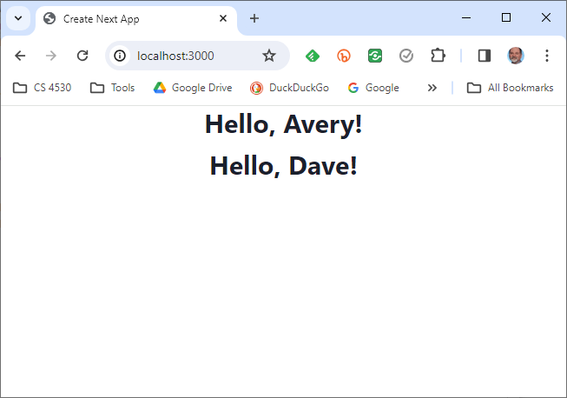

Slide 27
A component can pass handlers to its children
// create two CountingButtons, and keep track of the total count.
import { CountingButton } from './CountingButton';
export default function App() { const [globalCount, setGlobalCount] = useState(0)
function incrementGlobalCount() {
setGlobalCount(globalCount + 1)
}
return (
<VStack spacing='30px'>
<Box border="1px" padding='1'>Total count = {globalCount}</Box>
<CountingButton name="Button A" globalCount= {globalCount}
onClick={incrementGlobalCount} />
<CountingButton name="Button B" globalCount= {globalCount}
onClick={incrementGlobalCount} />
</VStack>
)
}
src/app/Components/TwoCountingButtons.tsx
Notes:
Let’s move on to how components can communicate with each other.
A common pattern is to nest components, passing values “down” from parents to children as props.
Here is an app that creates two CountingButtons, similar to what we had in the previous example. It passes each of them a name, and the handler it should use when it is clicked. The intention is that when the button is clicked, it should call incrementGlobalCount, which will increment the state variable globalCount.
<Demo>
In this example, you'll see some styling. In our examples, we've put in the smallest amount of styling to make the page easily readable. You can go to town with the styling-- Chakra has more styling options than you can count-- but we won't spend time on that because it doesn't advance our main story, which is the structure of React applications.
A good easy exercise is to modify this example so that each counting button also displays the global count.
React may complain that this example is missing an attribute called 'key'. Don't worry about that for the moment; we'll talk about that at the end of this video.

Slide 28
A child communicates with its parent by calling the handler it was passed
export function CountingButton(props: {
// display name of the button
name: string;
// global count from parent
globalCount: number;
// event handler to call when clicked
onClick: () => void;
}) {
const [localCount, setLocalCount]
= useState(0);
function handleClick() {
setLocalCount(localCount + 1);
props.onClick(); // propagate to parent
}
return (
<VStack>
<Box>
local count for {props.name} = {localCount}
</Box>
<Box>
globalCount = {props.globalCount}
</Box>
<Button onClick={handleClick}>
Increment {props.name}!
</Button>
</VStack>
);
}
src/app/Components/CountingButton.tsx
Notes:
And here’s the definition of CountingButton. The key bit of code is highlighted in yellow: handleClick, in addition to updating the local count, calls props.onClick, to invoke whatever handler the parent has passed to it.
If you think in terms of callbacks, you may find it helpful to think props.onClick as a callback to the parent.
Let's look at the preceding slide again. <Don't go back, go forward to the copy of the preceding slide>

Slide 29
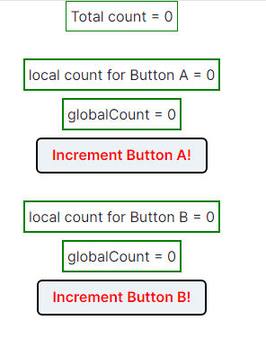
TwoCountingButtons demo
Notes:
<Demo, with console open>
Observe that pushing button A increments its own count, and also updates the total count. And similarly for button B.

Slide 30
Setters initiate the redisplay process
A setter sends a request to React.
Every so often, React collects all the set requests it has received since the last redisplay.
React executes all the outstanding set requests.
Last, React redisplays the component with the new state.
When a component re-renders, its children retain their state; the children are re-rendered only if their props change.

Slide 31
React works hard to make redisplay fast.
Updating the DOM in the browser is slow - it is vital that React does efficient diff’ing
Example: adding a new comment on a YouTube video shouldn’t make the browser re-layout the whole page
React makes re-rendering faster by updating only the part that changes.
This is called “Reconciliation”

Slide 32
A New Pattern: display a list of items using map
export function ToDoListDisplay(props: { items: ToDoItem[],
onDelete:(id:string) => void })
return (
<Table>
<Tbody>
{
props.items.map((eachItem) =>
<ToDoItemDisplay item={eachItem}
key={eachItem.id}
onDelete={props.onDelete} />)
}
</Tbody>
</Table>
)
}
src/app/Apps/ToDoApp/ToDoListDisplay.tsx
Notes:
As we said, in all our previous examples, our parent component had a fixed number of children (in our case, two)
But what if we needed a variable number of children? For example, we might have a todo app that displays each item in a to-do list.
The solution to the problem is to use map. Evaluating the map gives a nice list of components, which are here displayed vertically (since they are rows in a table).
Let's look at this app in a little more detail.

Slide 33
But using map comes with a big gotcha.
export function ToDoListDisplay(props: { items: ToDoItem[],
onDelete:(id:string) => void })
return (
<Table>
<Tbody>
{
props.items.map((eachItem) =>
<ToDoItemDisplay item={eachItem}
key={eachItem.id}
onDelete={props.onDelete} />)
}
</Tbody>
</Table>
)
}
Notes:
When you use map to display a list of items, each item must have a property that uniquely identifies it, and it must be called key. Otherwise, when REACT goes to redisplay the list, it doesn't know which elements are new and which are kept from the previous display.
Sometimes React will give you an error if you don’t pass a `key` attribute; sometimes it will just do strange wrong things.
Let's look at a typical example to see how to set up a key attribute.

Slide 34
The ToDo App
src/app/Apps/ToDoApp/ToDoApp.tsx
export default function ToDoApp () {
const [todoList,setTodolist] = useState<ToDoItem[]>([])
const [itemKey,setItemKey] = useState<number>(0) // first unused key
function handleAdd (title:string, priority:string) {
if (title === '') {return} // ignore blank button presses
setTodolist(todoList.concat({title: title, priority: priority, key: itemKey}))
setItemKey(itemKey + 1)
}
function handleDelete(targetKey:number) {
const newList = todoList.filter(item => item.key != targetKey)
setTodolist(newList)
}
return (
<VStack>
<Heading>TODO List</Heading>
<ToDoItemEntryForm onAdd={handleAdd}/>
<ToDoListDisplay items={todoList} onDelete={handleDelete}/>
</VStack>
)
}
Notes:
To illustrate this, let’s look at a ToDoApp. Here the master component keeps a list of todo items, and it has functions for handling a new item (coming from ToDoItemEntryForm), and for handling a deletion (coming from ToDoListDisplay).
It assigns a fresh key every time a new item is added.
Let’s look at this in action….

Slide 35
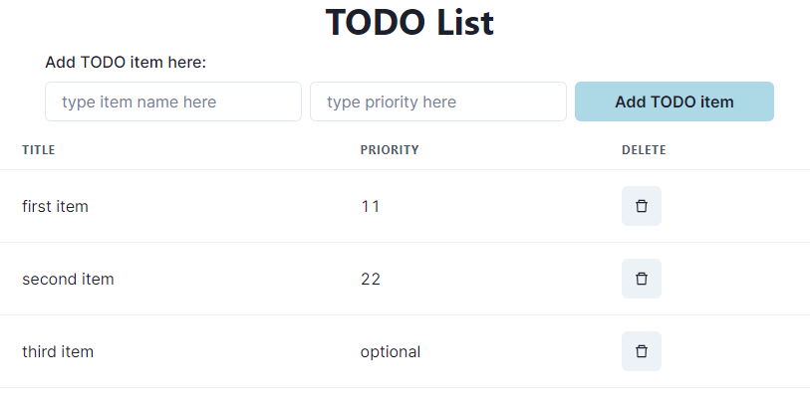
Typical Page
Notes:
Here's a typical page. As usual, we’ve used a minimum of styling.
<Do a demo, including adding items and deleting from the middle of the list>

Slide 36
A new pattern: an input form
app/Apps/ToDoItemEntryForm.tsx
export function ToDoItemEntryForm (props: {onAdd:(item:ToDoItem)=>void}) {
// state variables for this form
const [title,setTitle] = useState<string>("")
const [priority,setPriority] = useState("")
const [key, setKey] = useState(0) // key is assigned when the item is created.
function handleClick(event) { --- } // on next slide…
return (
<VStack spacing={0} align='left'>
<form>
<FormControl>
<VStack align='left' spacing={0}>
<FormLabel as="b">Add TODO item here:</FormLabel>
<HStack w='200' align='left'>
<Input
name="title"
value={title}
placeholder='type item name here'
onChange={(event => {
setTitle(event.target.value);
console.log('setting Title to:', event.target.value)
})}
/>
The state of the form is kept in the state variables of the component
One <Input> component for each blank space in the form.
Update the state variable at every keypress
Notes:
Another thing we need to do is to get textual input into our app.
Here we set up an input form as what's called a "controlled component", meaning that the form entries are set in React component variables.
Inside the <FormControl> you'll have one <Input> component for each blank in the form. Our form has two blanks: title and priority. Here we've shown only the component for the title.
Look at the highlighted code. Every keypress fires the `onChange` callback with a piece of React data called an 'event'. event.target.value contains the current string in the form. On every keypress, we call setTitle with the current string in the form, so that the user can see what they've typed.
<Demo>

Slide 37
handleClick
// state variables for this form
const [title,setTitle] = useState<string>("")
const [priority,setPriority] = useState("")
function handleClick(event) {
event.preventDefault() // magic, sorry.
props.onAdd(title,priority) // tell the parent about the new item
setTitle('') // resetting the values redisplays the placeholder
setPriority('') // resetting the values redisplays the placeholder
}
Notes:
When we handle a click, signifying that we are ready to add the todo item, we send the data to the caller, using the `onAdd` procedure that the caller sent to us. Then we update the component variables to be ready for the next item. Resetting the values to their defaults causes the placeholder (e.g. 'type item name here') to be redisplayed.
preventDefault is preventing browser from default behavior which is typically a refresh. Since we are using react to control the rendering and re-rendering, we don’t need the browser to refresh to see changes.

Slide 38
Treat values of state variables as read-only
State can hold any kind of JavaScript value, including objects.
But you shouldn’t change objects that you hold in the React state directly.
Instead, when you want to update an object, you need to create a new one (or make a copy of an existing one), and then set the state to use that copy.
https://react.dev/learn/updating-objects-in-state
Notes:
One last gotcha before we go… <read slide>

Slide 39
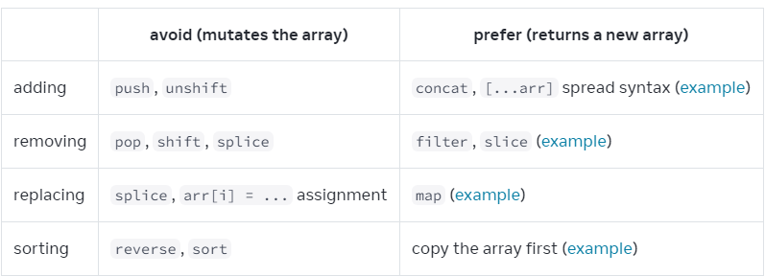
Array update cheat sheet
https://react.dev/learn/updating-arrays-in-state
Notes:
<read slide>
If you assign to a location in an array, React will not recognize it as a change, and your component will not update

Slide 40
Use spread to update an object
const [position, setPosition] = useState({ x: 0, y: 0 });
position.y = 10;
setPosition(position); // this will not trigger a re-render
setPosition({ ...position, y: 10 }); // this works
const [anArray, setAnArray] = useState([1, 2, 3]);
setAnArray([...anArray, 4]); // this works, too
Notes:
You can also use the spread operator to update one field of an object, or to extend an array.

Slide 41
Review
Now that you've studied this lesson, you should be able to:
Understand how the React framework binds data (and changes to it) to a UI
Create simple React components that use state and properties
In Module 09, we'll study another feature of React that enhances modularity: hooks.

